Slide 1
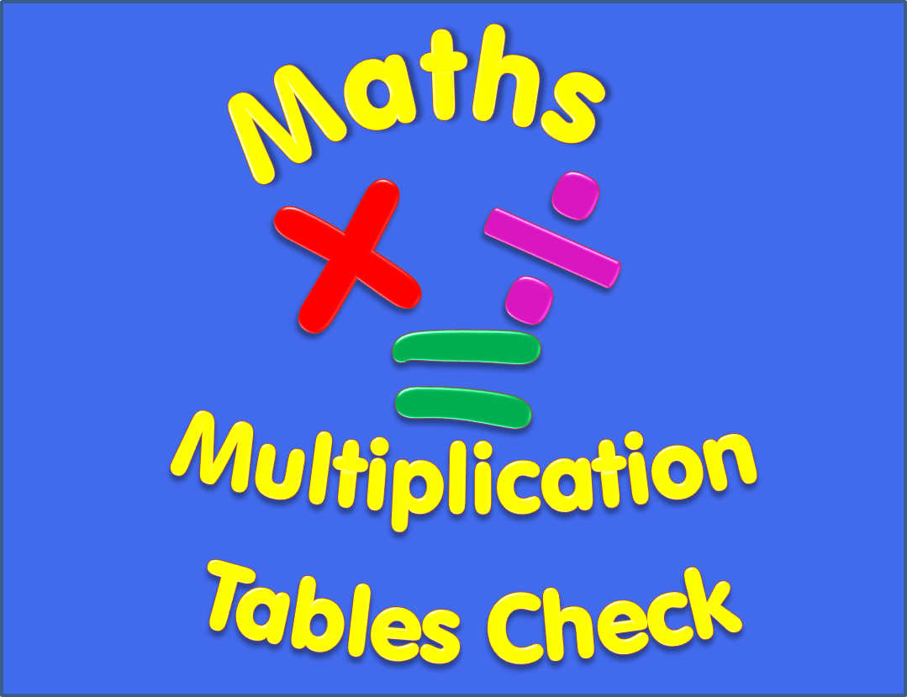

Slide 2
Begin
Instructions
There are 25 multiplication questions on any times table from 2 to 12.
Each multiplication question will appear on the screen for 6 seconds. There will then be a 3 second break before the next question appears.
Good Luck!

Slide 3
8 x 3
Q1

Slide 4
6 x 4
Q2

Slide 5
11 x 7
Q3

Slide 6
12 x 7
Q4

Slide 7
7 x 8
Q5

Slide 8
7 x 6
Q6

Slide 9
6 x 8
Q7

Slide 10
7 x 9
Q8

Slide 11
12 x 10
Q9

Slide 12
11 x 9
Q10

Slide 13
8 x 5
Q11

Slide 14
4 x 9
Q12

Slide 15
9 x 3
Q13

Slide 16
8 x 6
Q14

Slide 17
5 x 4
Q15

Slide 18
9 x 9
Q16

Slide 19
12 x 12
Q17

Slide 20
10 x 8
Q18

Slide 21
8 x 8
Q19

Slide 22
7 x 7
Q20

Slide 23
6 x 12
Q21

Slide 24
6 x 5
Q22

Slide 25
9 x 6
Q23

Slide 26
4 x 4
Q24

Slide 27
3 x 12
Q25

Slide 28
Completed!
All multiplication questions have now been shown.
To find out your score click on the button below.
Answers

Slide 29
Answers
1) 8 x 3 = 24 2) 6 x 4 = 24 3) 11 x 7 = 77
4) 12 x 7 = 84 5) 7 x 8 = 56 6) 7 x 6 = 42
7) 6 x 8 = 48 8) 7 x 9 = 63 9) 12 x 10 = 120
10) 11 x 9 = 99 11) 8 x 5 = 40 12) 4 x 9 = 36
13) 9 x 3 = 27 14) 8 x 6 = 48 15) 5 x 4 = 20
16) 9 x 9 = 81 17) 12 x 12 = 144 18) 10 x 8 = 80
19) 8 x 8 = 64 20) 7 x 7 = 49 21) 6 x 12 = 72
22) 6 x 5 = 30 23) 9 x 6 = 54 24) 4 x 4 = 16
25) 3 x 12 = 36

